Slide 1

git
An Introduction
What is it?
Why should you use it?
How does it work?

Slide 2
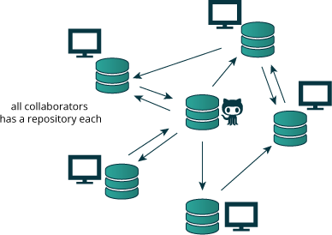
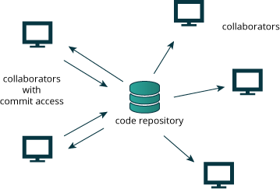
What is it?
“Git is a free and open source distributed version control system, which is fast and efficient.“
- Git Homepage
Version control system = tracks versions of files
e.g. source code, LaTeX thesis, paper or talk, website html, etc. (Rule of thumb: Everything you edit in text editors)
Distributed = everyone has a full local copy of the repository
distributed
centralized
2

Slide 3

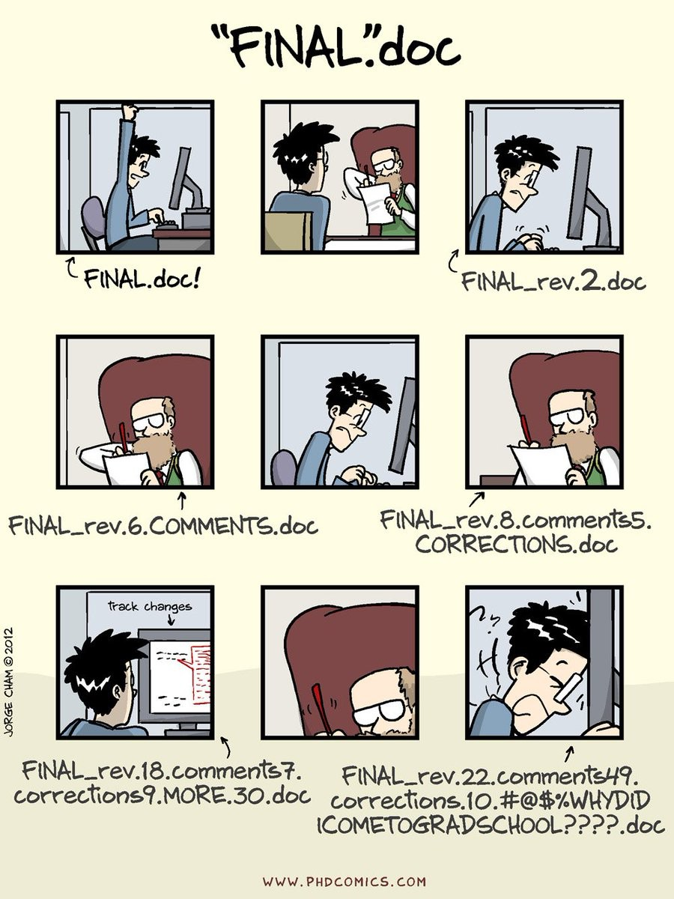
Why should you use it?

Slide 4
Why should you use it?
It helps you!
Transparent history of all changes
Moving back and forth in time
Everything is easily traceable and reversible (e.g. errors) Good scientific practices:
Reproducibility and traceability
Enables collaboration

Slide 5
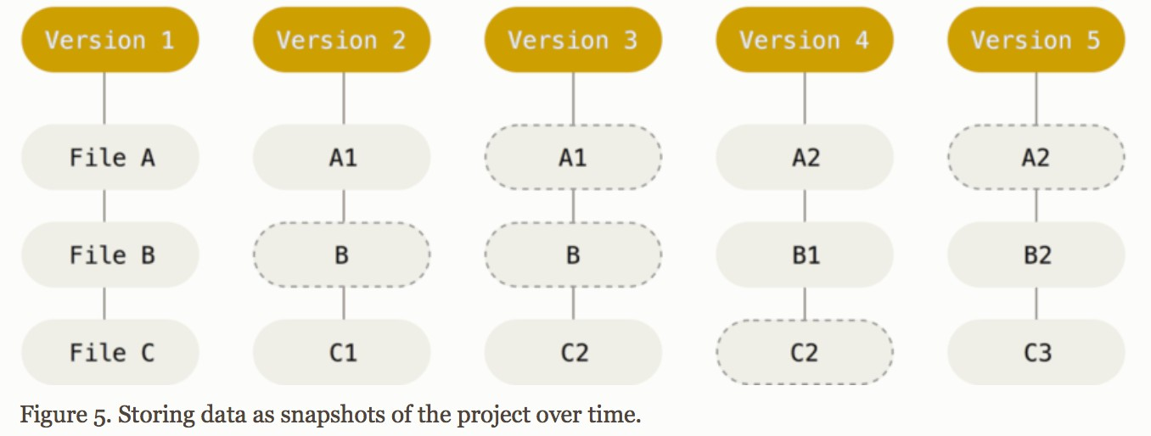
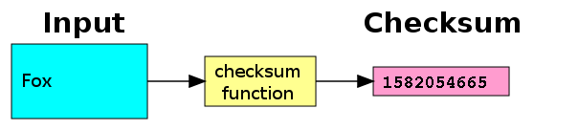
How does it work?
Repository = database containing all versions of the files
Snapshot-based system
Snapshots are called commits
Commits are named by checksums (also used to ensure data integrity)
Almost every operation is local
Working without network connecting
Distributed system (everyone carries a backup)
https://git-scm.com/book/en/v2/Getting-Started-Git-Basics
5

Slide 6

How does it work?
4 distinct places
local
also staging area
All of your (to be) edited project files
For now: All changes go here first
(Later: Helps disentangling changes)
Manually synced copies of all committed versions of all project files

Slide 7
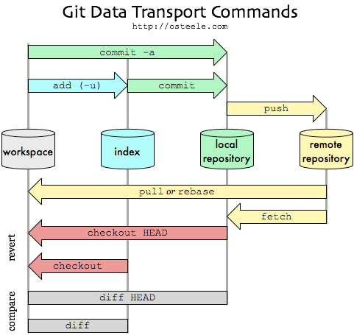
How does it work?
Overview of most common commands
Most common use by command line
(Not discussed)
status
also staging area
Don’t Panic
This is an introduction.
It is worth it.
log
diff --staged

Slide 8
Gist of this Introduction
Command by command
The basic workflow: Set up a local repository and save changes to it
—> Exercise 1
Branches: Work on different features in parallel
—> Exercise 2
Basic interactions with a remote repository

Slide 9
Notation
$
what follows are commands to be entered on the command
line e.g.
$ git log
<…>
marks names and other variables that change during
use e.g.
$ git branch <branch_name>
Advanced:
Tips for more advanced user will be in green boxes

Slide 10
$ git help
Get help for any command
$ git help <command>
$ git <command> --help
$ man git-<command>
Works oﬄine!
Installation: Good changes it is already installed, if not [Link]

Slide 11
Commands
config init status add commit diff log
branch checkout merge
clone push pull

Slide 12
$ git config
Before doing anything else: Identify yourself
$ git config --global user.name <your_name>
$ git config --global user.email <your_email>
Make sure this is consistent across all your machines
Advanced:
Aliases
„Did you mean?“
Make your life easier: Set up tab completion [Link]
$ git config --global alias.st „status“
$ git config --global help.autocorrect 10

Slide 13
$ git init
Initalizing a empty (local) Git repository
$ git init
Initialized empty Git repository in /path/to/ example_repo/.git/
Adds a hidden .git directory, where git stores all of its information
Git only uses relative paths (source directory can be moved freely)

Slide 14
$ git status
Display status information of working directory and staging area
$ git status
On branch master
No commits yet
Untracked files:
(use "git add <file>..." to include in what will be committed)
hello.cpp
nothing added to commit but untracked files present (use "git add" to track)
(Output for a newly initialized repo with one new file hello.cpp)

Slide 15
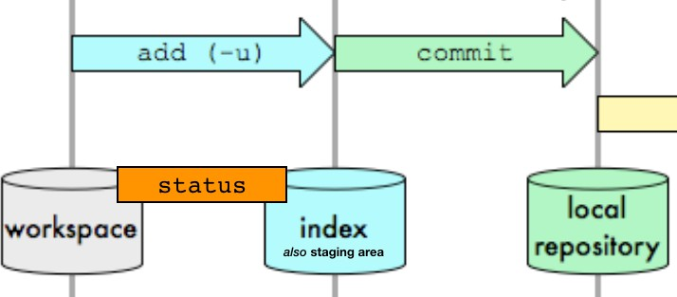
$ git add
Adding changes to the staging area
$ git add <file_name>
Adds all changes of a file to the staging area
$ git add <directory_name>
Adds all changes of all files in the directory to the staging area.
Advanced:
You can also add only specific changes to a file (so called hunks) to the staging area.
Ignore certain files with .gitignore [Link]
$ git add -p <file_name>

Slide 16
$ git commit
Committing staged changes to your repository
$ git commit
External text editor (most likely vi) will open and ask for a commit message
Don’t like vi:
$ git config --global core.editor „nano“
Invest in good commit messages!
Subject line + body (Follow 50/72 rule [Link])
Write them like a email to yourself / the other developers
Document why you made the changes
Good commits are small and often, conceptually separated, only include source files & at best working code

Slide 17
$ git diff
Display changes to your tracked files
$ git diff
To be precise: Differences between working directory and staging area ➡ only unstaged changes
Helpful to inspect what you have done

Slide 18
$ git log
Display history of your commits
$ git log
See the last changes that were made
including the commit message (at least per default)

Slide 19
Exercise 1
config init status add commit diff log
branch checkout merge
Solutions
can be found at the end of the slides

Slide 20
Exercise 1
Configure your git setup by setting your name and mail address. If you done that, check the .gitconfig file in your home
directory.
Create a new directory and initialize an empty git repository in it.
Create a simple sample code file in the directory and commit it.
Modify the sample code file and commit the changes. Check the changes first.
Look at the commit history you created.
Optional: If you currently work on a "code" project (remember, this also might e.g. be a LaTeX paper project), repeat step 2 and 3 and make it git repository. Instead of creating a sample file, you just commit your source files. Do not worry, your project files will remain untouched by this. The next time you change your project files, just commit your changes (step 4 and 5). Just continue to repeat step 4 and 5 every time you work on your project and you will have already mastered the main git workflow.

Slide 21
Basic Workflow
WORK
git status / git diff git add
git commit

Slide 22
$ git commit -a
Directly commit unstaged changes
Advanced:
$ git commit -a
Stage all changes to tracked files at once
Shortcut for
$ git add -u
$ git commit
$ git add -u
What is the purpose of the staging area?
Allows to only commit part of your changes (Assemble your commit to your liking)
Split changes across commits
Also other use cases e.g. for reviewing your changes, …

Slide 23
Commands
config init status add commit diff log
branch checkout merge
clone push pull

Slide 24

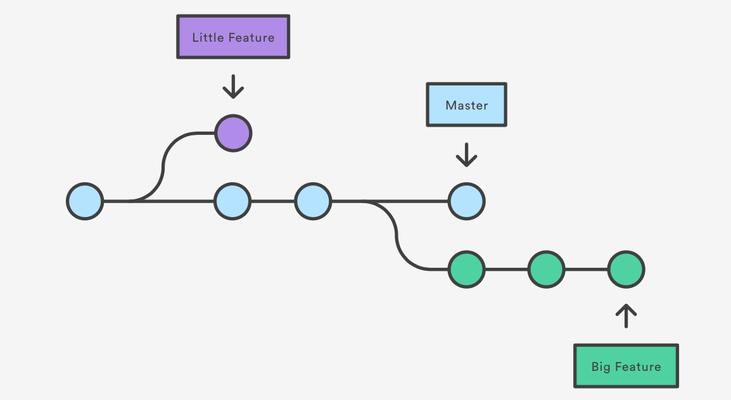
Branches
Branches store different versions of your project
Parallel development
Implement new features
Fix bugs
Try out something
Cheap to do in git
(technically just pointers to a commit)
Main branch = master
https://www.atlassian.com/git/tutorials/using-branches
By default created at initialization
Usually development is done on other (feature) branches

Slide 25
$ git branch
Create new branch
$ git branch <branch_name>
List all branches of local repository
$ git branch
Delete branch
$ git branch -d <branch_name>
Save option to delete a branch, since it prevents data loss
$ git branch -D <branch_name>
Use CAREFULLY! Be sure you want to lose this progress

Slide 26
$ git checkout
for branches
Switch between existing branches
$ git checkout <branch_name>
Changes your project files
Only works with no uncommitted changes („Clean working tree“)
Shortcut: Create and checkout new branch
$ git checkout -b <new_branch_name>

Slide 27
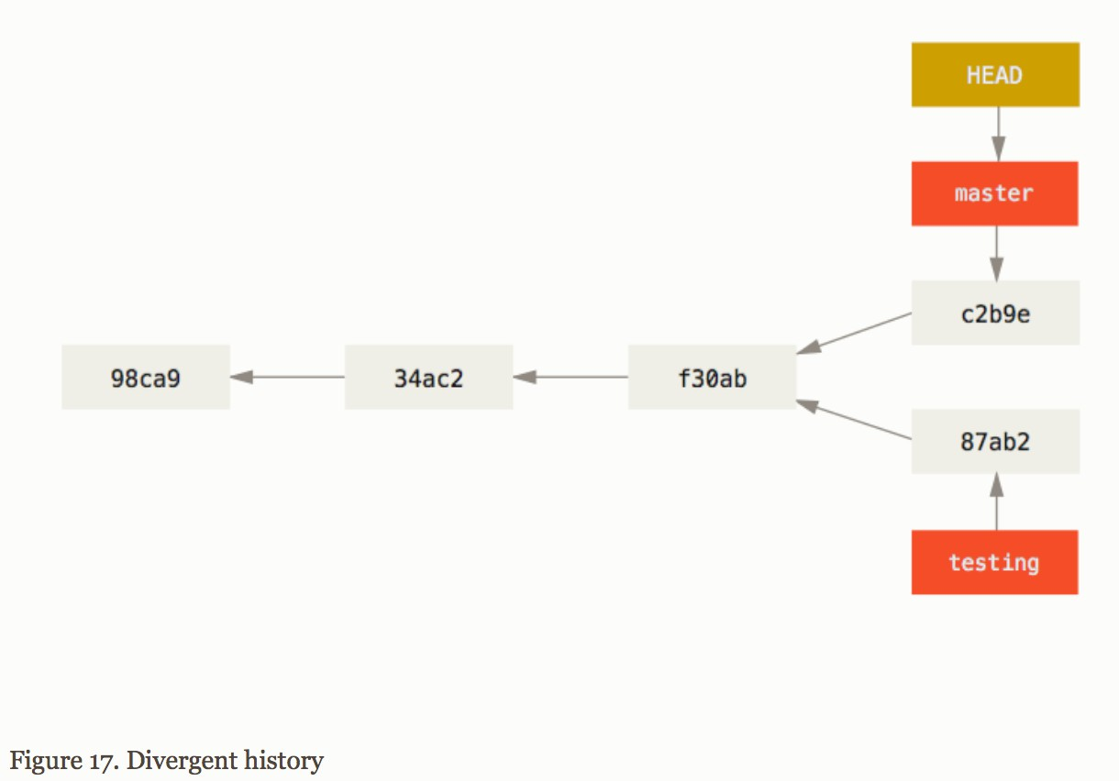


The HEAD
HEAD = special pointer to currently checked out branch (commit)
$ git checkout master
$ git checkout testing
https://git-scm.com/book/en/v2/Git-Branching-Branches-in-a-Nutshell

Slide 28

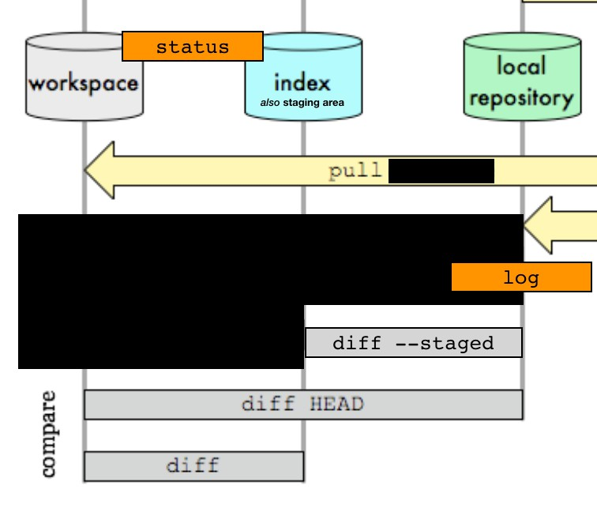
$ git diff
Complete Overview
Display changes to your tracked files
$ git diff
already discussed
To be precise: Differences between working directory and staging area ➡ only unstaged changes
Helpful to inspect what you have done
$ git diff HEAD
Differences between working directory and HEAD (last commit)
$ git diff --staged
Differences between staging area and HEAD

Slide 29
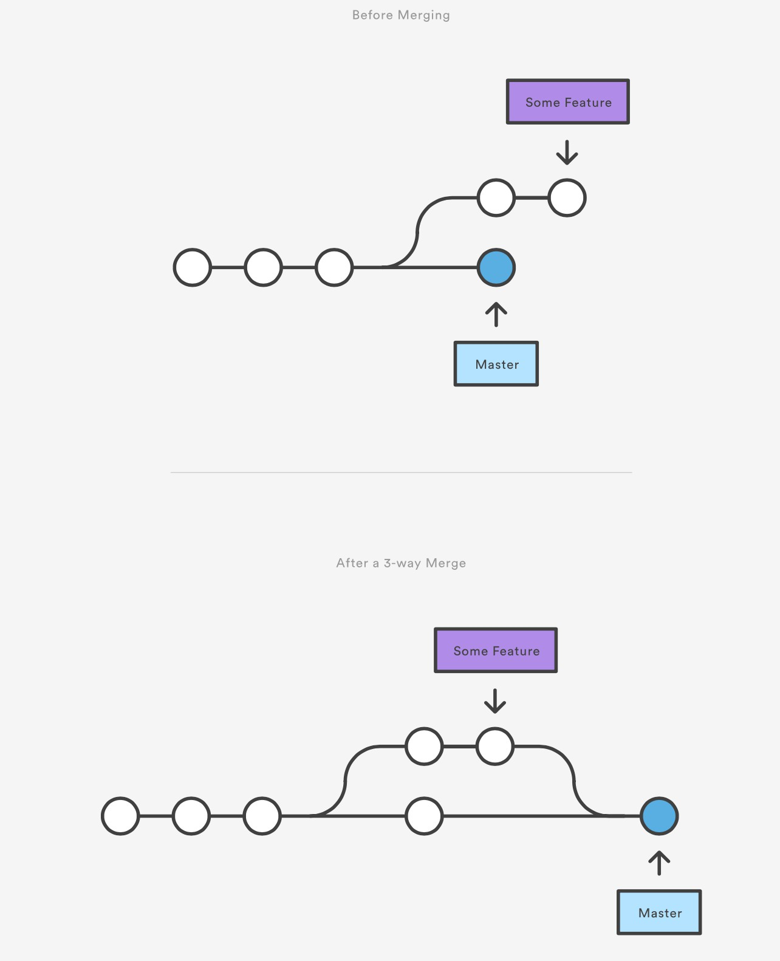
$ git merge
Merge changes in checked out branch
$ git merge <feature_branch>
Smart automatic three-way merges
Only changes the checked out branch (ensure you are on the correct branch)
https://www.atlassian.com/git/tutorials/ using-branches/git-merge

Slide 30
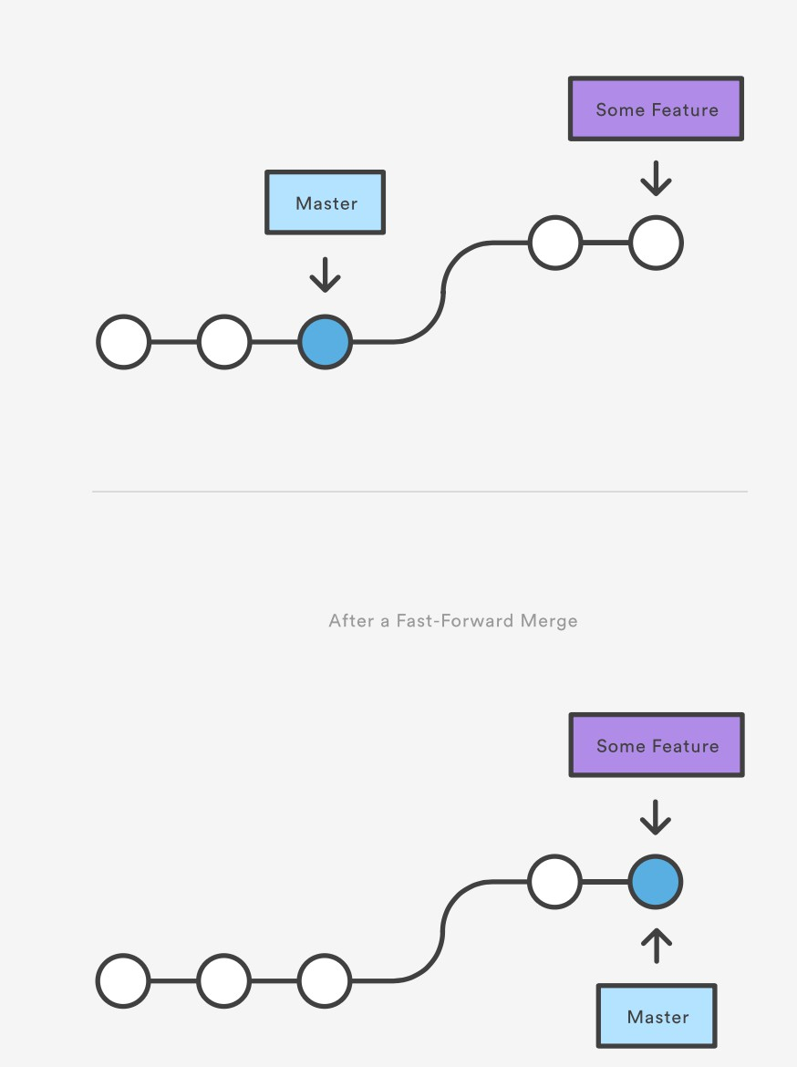
$ git merge
Two different merges:
Fast-forward
Three-way
Only three-way merges have merge commits
and potential merge conflicts
https://www.atlassian.com/git/tutorials/using-branches/git-merge

Slide 31
$ git merge
Merge conflicts
$ git merge <branch_name> Auto-merging <file>
CONFLICT (content): Merge conflict in <file>
Automatic merge failed; fix conflicts and then commit the result.
Conflicts if same part of file (hunk) is changed in both branches
Resolve
Run git status to see „unmerged paths“
Find problematic hunks: Highlighted in files by
<<<<<<< , =======, >>>>>>>
…
<<<<<<< HEAD
std::cout << "Hello!“;
=======
std::cout << „Goodbye!“;
>>>>>>> say_goodbye_branch
…
Create the intended code version and remove <<<<<<< ,…
Then git add <file_with_merge_conflict>
git commit (Auto-generated merge commit message)
…
std::cout << „Goodbye!“;
…

Slide 32
Commands
config init status add commit diff log
branch checkout merge
clone push pull

Slide 33
Exercise 2
config init status add commit diff log
branch checkout merge
Solutions
can be found at the end of the slides

Slide 34
Exercise 2
Create a new branches and check that you created them by looking at the branch list.
Delete the new branches right away without risking data loss.
Create and directly switch to another new branch (e.g. name it add_readme) using only one command. Check again that you created the branch and that it is checked out.
Add a new file on the branch (e.g. a README) and commit the new file.
Switch back to master. Verify that the new file is gone. Merge the branch with the new file (Notice that this was a fast-forward merge). Check the history and that the new file is now reappeared. Safely delete the merged branch, which is possible now that the changes are in master.
Provoke a merge conflict by creating a new branch (e.g. name it edit_sample_file) and change the sample file from Exercise 1. Commit the changes on the new branch. Edit the same part of the file back on master and also commit the changes. Now, try merging the new branch with the edited sample file.
Fix the merge conflict.

Slide 35
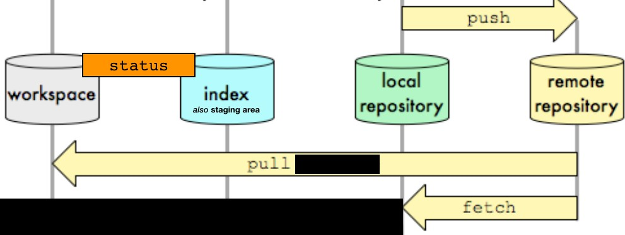
Interacting with Remotes
So far everything were local operations
Following interactions with a remote repository require network connection
Remote repositories enable collaboration and backup
Local repository has to be manually synced with remote repository
Advanced:
Note: In the following only tracking branches are used to interact with a remote repository to keep it simple.

Slide 36
$ git clone
Clone (download) a remote repository
$ git clone <link_to_repository>
Creates directory with project name in current directory Remote repository is (by default) referred to as origin You can also clone on the same machine locally
See all remote branches of repository
$ git branch -r
Branches that are in remote are prefixed by
origin/ then the <branch_name>

Slide 37
$ git pull
Checkout a branch of the repository (as usual)
$ git checkout <branch_name>
Do not use the origin/ prefix here
Update a branch with the new version from the remote repository
$ git pull
… while the branch is checked out Changes your working directory
Make sure you pull before committing and merging to stay
in sync! (especially on master, maybe someone else updated it)

Slide 38
$ git push
Create a new branch in the remote repository
$ git push -u origin <branch_name>
from the currently checked out branch
Update the remote branch from the local branch afterwards
$ git push
Only changes that are committed are pushed
If the remote and local history diverge (e.g. forgot to pull before committing) pushes will be rejected
Make sure you push after committing and merging to stay in sync!
38

Slide 39
The Rest
Other useful commands worth looking up yourself
$ | git | stash | Quickly stash away your changes for later to obtain clean working tree
$ | git | revert | Undoing changes and commits
$ | git | reset | —> good tutorial under this [Link]
$ | git blame <file> |  | See line for line, who and which commit is responsible for the last change to this line
Bisect the git history to find which commit introduced a bug
$ git bisect

Slide 40
Summary
config init status add commit diff log
branch checkout merge
clone push pull
(Not discussed)
status
also staging area
log
diff --staged

Slide 41
Solutions to Exercise 1
# Part 1 #
$ git config --global user.name <your_name>
$ git config --global user.email <your_email>
$ less ~/.gitconfig
# Part 2 #
$ mkdir sample_project; cd sample_project
$ git init
$ ls -a # see hidden .git directory
# Part 3 #
$ vi sample_file.cpp # create sample file
$ git status
$ git add sample_file.cpp
$ git status
$ git commit # editor open, type commit message, save and quit
# Part 4 #
$ vi sample_file.cpp # modify sample file
$ git diff
$ git status
$ git add sample_file.cpp
$ git status
$ git commit # editor open, type commit message and save
# Part 5 #
$ git log

Slide 42
Solutions to Exercise 2
Part 1/2
# Part 1 #
$ git branch new_branch
$ git branch
Builds on repository created for Ex. 1
# Part 2 #
$ git branch -d new_branch
# small d important
# Part 3 #
$ git checkout -b add_readme
$ git branch # star marks the currently checked out branch
# Part 4 #
$ vi README.md
$ git status
# create README file
$ git add README.md
$ git commit
$ git status # shows working tree clean, so we can check out another branch
# Part 5 #
$ git checkout master
$ ls # README is gone again
$ git merge add_readme # notice it says fast-forward merge
$ git log # has commit from add_readme
$ ls # README file now on master
$ git branch -d add_readme

Slide 43
Solutions to Exercise 2
Part 2/2
# Part 6 #
$ git checkout -b edit_sample_file
$ vi sample_file.cpp # modify file
$ git diff # always check you changes
$ git commit -a # only small change
$ git checkout master
$ vi sample_file.cpp # modify same part/line of file
$ git diff
$ git commit -a
$ git merge edit_sample_file # should have a merge conflict
# Part7 #
$ git status # see unmerged paths
$ vi sample_file.cpp # create intended code version + rm comments
$ git add sample_file
$ git commit # auto-generated merge commit message

